Slide 1

Pneumonia Detection Using Chest X-Rays and Convolutional Neural Networks
Group A: Abdikadir, Ang, Lai

Slide 2




OUTLINE OF REPORT
I. PROJECT BACKGROUND
II. DATA PREPROCESSING
Normal vs. Pneumonia
Dataset Background
Addressing Class Imbalance
Additional Augmentation
III. ARCHITECTURE
IV. OPTIMISATION
CNN Adaptation from VGG-16
Hyperparameters and Dropout
Mini-batch stochastic gradient descent with momentum
Cyclical Learning Rate Scheduling
Notes:
we’ll first discuss the topic we chose and background on our dataset, then data processing and how we dealt with issues like class imbalance. secondly, the model architecture and our approach to optimising the model. lastly and most importantly what results did we obtain and how did our model do against an adversarial attack.

Slide 3


OUTLINE OF REPORT
V. RESULTS
VI. ADVERSARIAL ATTACK
Accuracy, Matthews Correlation Coefficient
Confusion Matrix
Fast Gradient Sign Method (FGSM)
Universal Adversarial Perturbation

Slide 4


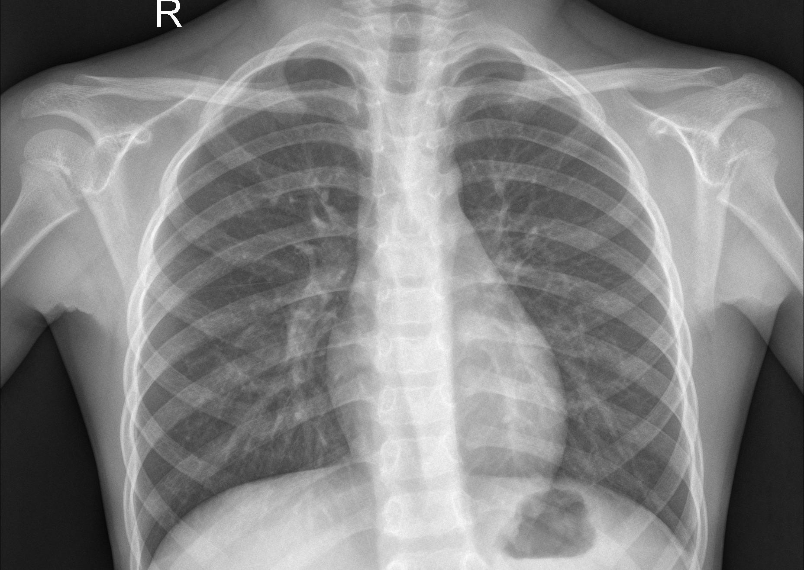
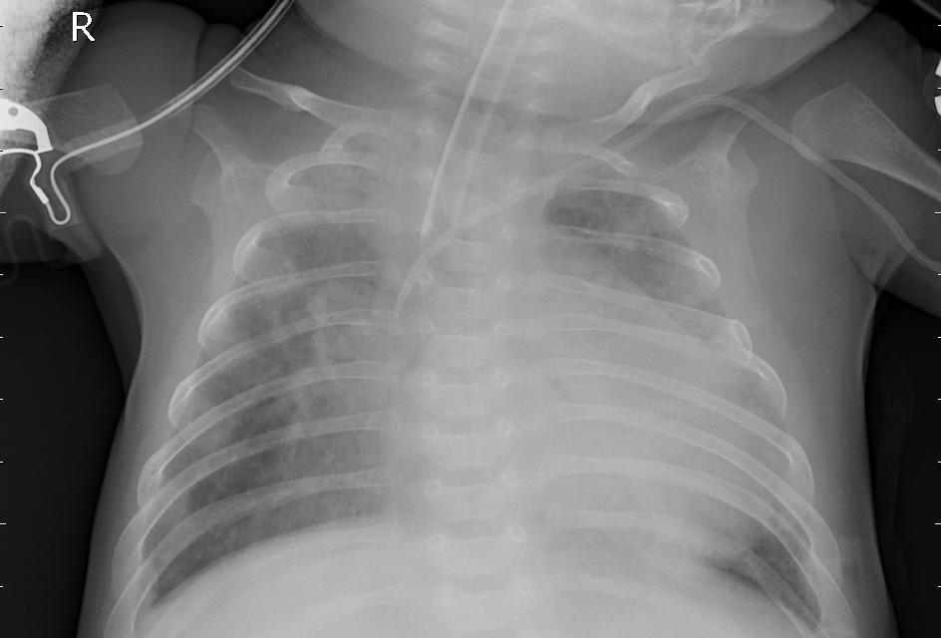
BACKGROUND
INTRODUCTION
Project Aim:
Classifying chest X-ray images for pneumonia detection
On Pneumonia:
Lung infection that may cause fluid accumulation (usually visible as hazy patches).
NORMAL
PNEUMONIA
NHS. 2019. Pneumonia. https://www.nhs.uk/conditions/pneumonia/
Paul Mooney. 2018. Chest X-Ray Images (Pneumonia). https://www.kaggle.com/paultimothymooney/chest-xray-pneumonia
Notes:
The aim of our project was Classifying chest X-ray images for pneumonia detection. So, what is pneumonia? Pneumonia can be caused by various types of infections such as Bacteria, viruses, and fungi. Each type may have different manifestations in x-ray images. Such differences make the classification tasks more difficult.

Slide 5
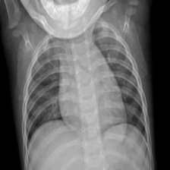

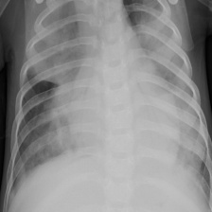

DATASET BACKGROUND
SIZE UNIFORMITY
RESIZING
1468 x 993 x 3
224 x 224 x 3
932 x 588 x 3
224 x 224 x 3
Stéfan van der Walt, Johannes L. Schönberger, Juan Nunez-Iglesias, François Boulogne, Joshua D. Warner, Neil Yager, Emmanuelle Gouillart, Tony Yu, and the scikit-image contributors. 2014. scikit-image: Image processing in Python. https://doi.org/10.7717/peerj.453
Notes:
We resized our dataset from to 224x224x3 we did this because JPEG format have to take 3 channels even if the images are grey scale.

Slide 6


DATASET BACKGROUND
SUMMARY
Features
Target Variables
3 x 224 x 224 pixel values
Pneumonia
Normal
 | TRAIN | VALIDATION | TEST
TOTAL | 5,106 | 100 | 624
NORMAL (%) | 1,308 (25.61%) | 40 (40%) | 234 (37.5%)
PNEUMONIA (%) | 3,798 (74.38%) | 60 (60%) | 390 (62.5%)
Paul Mooney. 2018. Chest X-Ray Images (Pneumonia). https://www.kaggle.com/paultimothymooney/chest-xray-pneumonia
Notes:
In summary, our data consist of 5830 images with each having 224x224x3 pixels which we got from Kaggle and was already split into 3 categories training, validation and testing. However, the validation set was far too small as a result we moved several training samples to increase our validation sample to 100. As shown in the table, all training, testing and validation set have class imbalances with there being significantly more pneumonia images than normal.

Slide 7
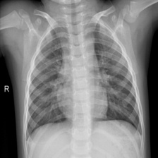
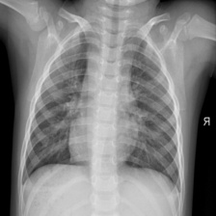
DATA AUGMENTATION
TACKLING CLASS IMBALANCE
Increase number of NORMAL samples by mirroring images
BEFORE
AFTER
 | TRAIN | VALIDATION | TEST
TOTAL | 6,414 | 100 | 624
NORMAL (%) | 2,616 (40.79%) | 40 (40%) | 234 (37.5%)
PNEUMONIA (%) | 3,798 (59.21%) | 60 (60%) | 390 (62.5%)
Notes:
To combat such class imbalance issue, we applied horizontal flipping to the normal images. However, this was only applied to the training set as in practice we are likely to encounter class imbalances in test set. Therefore, the validation and test set are kept unchanged for better generalisability.
Note that we didn't completely remove the imbalance as in medical diagnosis, false negative is considered more significantly more costly than false positive. Therefore, a slight imbalance might help to improve our recall.

Slide 8
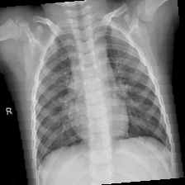
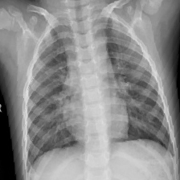
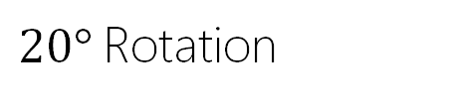
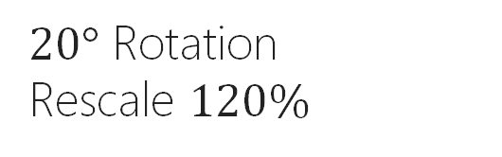
DATA AUGMENTATION
GOAL: Improve robustness of classifier by increasing variability in the dataset
BEFORE
$20°$ Rotation
Applied with 50% probability
$20°$ Rotation
Rescale $120\%$
Notes:
On top of the horizontal flipping, we also applied two additional data augmentation strategies which are 20% rotations and 120% rescale. Both of which are applied with probability of 0.5. Similar to the horizontal flipping, both strategies are only applied to the training set to increase the variability of our dataset in hope of decreasing the chances of overfitting

Slide 9
NETWORK ARCHITECTURE
Dropout(10%)
Model as simplified version of VGG-16
Total parameters: 59,889,282
Image
Conv (64 x 5 x 5)
Conv (128 x 5 x 5)
Conv (256 x 5 x 5)
Conv (512 x 5 x 5)
Flatten
FC (2048)
FC (2048)
FC (2)
2x2 Max Pooling
2x2 Max Pooling
2x2 Max Pooling
4x4 Max Pooling
224 x 224 x 3
224 x 224 x 64
112 x 112 x 128
56 x 56 x 256
28 x 28 x 512
7 x 7 x 512
25088 to 2048
2048 to 2048
2048 to 2
Andrew Ng. 2017. C4W2L02 Classic Network. https://www.youtube.com/watch?v=dZVkygnKh1M
Notes:
Now we got the data, let’s build a convolutional neural network
Our current model is adapted
Adapted from VGG-16
we start with 64 filters. This number gets doubled as we add another convolutional layers.
For all convolutional layers,
We used filters of size 5x5 with stride equals to one
The inputs for these layers are padded with 2 layers of zeros on each side (move to the next slide )
Between two convolutional layers,
We first applied relu-activation function and then shrank the height and width of the images using max-pooling.
After the four convolutional layers,
We flatten our image matrix into a vector and passed it through three fully connected layers with relu activations.
To decrease the chances of overfitting, we added 10% dropout to the fully connected layers.

Slide 10

NETWORK ARCHITECTURE
PADDING
Padded Matrix $p=2$
0 | 0 | 0 | 0 | 0 | 0 | 0 | 0 | 0
0 | 0 | 0 | 0 | 0 | 0 | 0 | 0 | 0
0 | 0 | 0.1 | 0.3 | 0.5 | 0.7 | 0.9 | 0 | 0
0 | 0 | 0.3 | 0.1 | 0.9 | 0.4 | 0.8 | 0 | 0
0 | 0 | 0.9 | 0.2 | 0.7 | 0.2 | 0.8 | 0 | 0
0 | 0 | 0.3 | 0.4 | 0.5 | 0.1 | 0.9 | 0 | 0
0 | 0 | 0.3 | 0.9 | 0.5 | 0.1 | 0.2 | 0 | 0
0 | 0 | 0 | 0 | 0 | 0 | 0 | 0 | 0
0 | 0 | 0 | 0 | 0 | 0 | 0 | 0 | 0
Original Data
0.1 | 0.3 | 0.5 | 0.7 | 0.9
0.3 | 0.1 | 0.9 | 0.4 | 0.8
0.9 | 0.2 | 0.7 | 0.2 | 0.8
0.3 | 0.4 | 0.5 | 0.1 | 0.9
0.3 | 0.9 | 0.5 | 0.1 | 0.2
Notes:
We set the padding to be 2, to prevent undersampling on the edges and keep the spatial dimension the same as before applying the convolutions

Slide 11
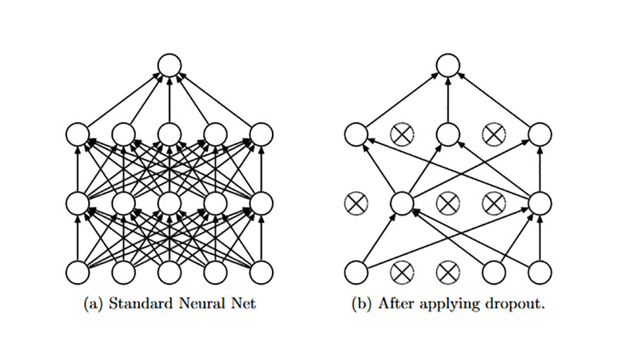
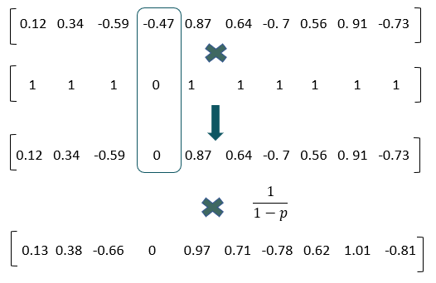
REGULARISATION
DROPOUT
$$p=ℙ\left(Deactivating Neuron\right)=0.1$$
Weidong Xu, Zeyu Zhao, and Tianning Zhao.Tutorial: Dropout as Regularization and Bayesian Approximation. https://xuwd11.github.io/Dropout_Tutorial_in_PyTorch/
Notes:
The basic idea behind dropout is that we randomly turn off neurons with a certain probability p which is set to 0.1 in our case.
Then we upscale the values by 1/(1-p) to keep the expectation approximately the same

Slide 12
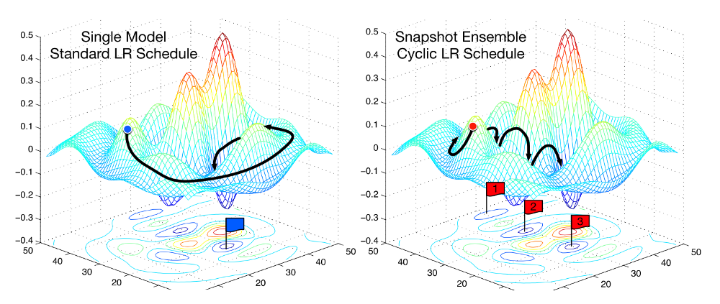





OPTIMISATION
Mini-batch stochastic gradient descent
Batch size: 16
Cyclical Learning Rate Schedule
Maximum Learning rate = 0.05
Minimum Learning rate = 0.015
$$k$$
$$m−k$$
Leslie Smith. 2017. Cyclical Learning Rates for Training Neural Networks. https://arxiv.org/pdf/1506.01186.pdf
Gao Huang, et al. 2017. Snapshot Ensembles: Train 1, Get M For Free. https://arxiv.org/abs/1704.00109
Notes:
Now we've built our network, how do we optimise it?
In this project, we used mini-batch stochastic gradient descent with batch size of 16.
This batch size is chosen, because considering our RAM is limited, using a bigger batch size imposes a greater limit of the number of epochs we are able to run.
And we believe that being able to run more epochs could be more useful for improving accuracy than using a bigger batch size.
Now regarding our learning rate, we employed the cylical learning rate schedule which works as follow.
We first initialised the minimum and the maximum learning rate.
Then our learning rate monotonically increases from the minimum and once we hit the maximum
It will come back down to the minimum
The rationale for using such a learning rate schedule is that by increasing the learning rates at various time points we are more likely to be able to traverse through the saddle point plateaus, which are often considered quite problematic when the learning rate is set at a small constant value.

Slide 13

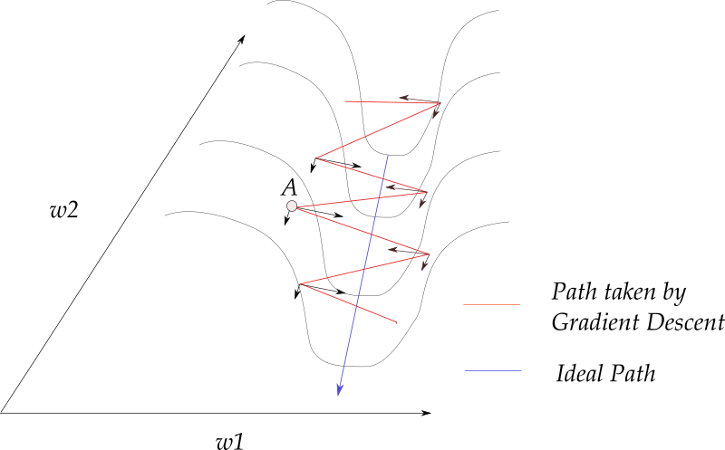
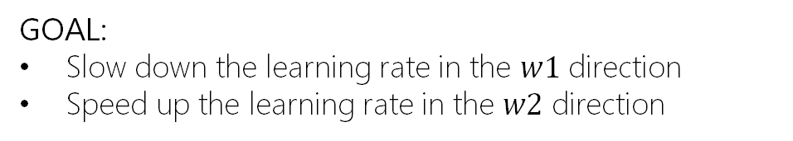
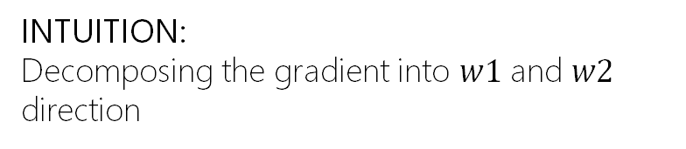


OPTIMISATION
MOMENTUM
INTUITION:
Decomposing the gradient into $w1$ and $w2$ direction
GOAL:
Slow down the learning rate in the $w1$ direction
Speed up the learning rate in the $w2$ direction
Momentum Parameter
$$V_{dw}^{t}=βV_{dw}^{t−1}+\left(1−β\right)dw$$
Exponentially weighted average of gradients from previous iterations
Gradient of current iteration
Weight update:
$$W^{t+1}=W^{t}−τV_{dw}^{t}$$
Ayoosh Kathuria. 2018. Intro to optimization in deep learning: Momentum, RMSProp and Adam. https://blog.paperspace.com/intro-to-optimization-momentum-rmsprop-adam/
Notes:
On top of the cylical learning rate, we also added momentum.
The intuition behind the momentum can be visualised in this picture.
Without momentum, the gradient updates are in a zig-zag manner, which could be decomposed into w1 and w2 directions (shown as the litte black arrows).
When we add the momentum, the components along the direction w1 cancel out, while the component along the w2 direction is reinforced.
now we can take a straight-forward path towards local minima.
The momentum is not static

Slide 14
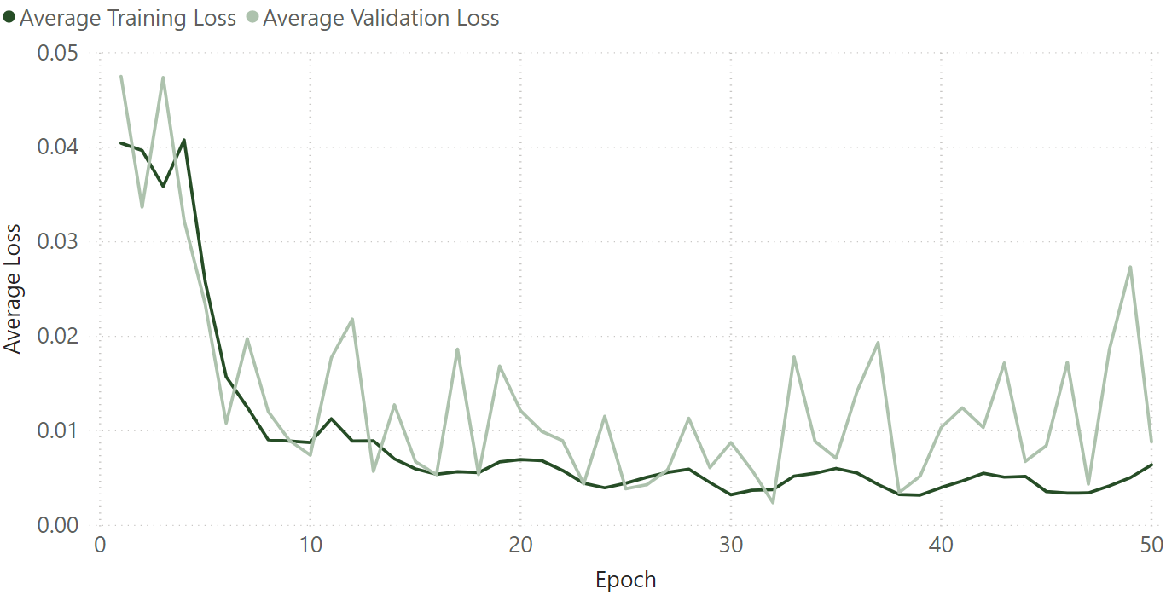
EARLY STOPPING
$$Loss_{tr}−Loss_{val}=0.000043$$
Notes:
Now we've built the optimiser but how many epochs do we need to run?
The first option we had was to stop when the validation loss stop decreasing.
The problem with that is that our size of validation set is pretty small althoug we have it from 16 to 100
We decided not to enlarge the validation set further as it will reduce the remaining amount of training data.
A small validation set tend to have a large stochastic error which could be observed from the graph here.
This kind of
errors could lead to misguided stopping decision.
So this leaves us with the second option:
Stop when the absolute difference between average train loss and average validation los is the smallest.
This means our Parameteres learned while training is almost equally representive on a unseen dataset
Following this rule, we stopped at the point where the training loss is just 0.000043 higher than validation loss, which is highlighted with the line here.
This gave us 85.58% test accuracy
(Since dropout was deactivated at the validation stage, we allowed for lower validation loss.
On top of this, we also experimented with the trial and error approach, which gave a better 88.94% test accuracy.
But the problem is that this approach is no empirically justified as we just tried a few stopping points and selected the one with highest test accuracy.
Although the accuracy was higher such we could not find any empircal justification for such a stopping point therefore we will focus our discussion on the second one instead.
A small validation set has a large stochastic error, which can lead to a misguided stopping decision. Enlarging the validation set yields a more reliable estimate of generalization, but reduces the remaining amount of training data, depriving the model of potentially valuable information. This trade-off is not easily resolved

Slide 15

RESULTS
 | TRAIN | VALIDATION | TEST
Average Loss | 0.005415 | 0.005372 | 0.034264
Accuracy | 97.16% | 97% | 85.58%
Matthews Correlation Coefficient | 0.94 | 0.94 | 0.699
$$MCC=\frac{TP x TN −FP x FN}{\sqrt{(TP+FP)(TP+FN)(TN+FP)(TN+FN)}}$$
Davide Chicco, and Giuseppe Jurman. 2020. The advantages of the Matthews correlation coefficient (MCC) over F1 score and accuracy in binary classification evaluation. https://bmcgenomics.biomedcentral.com/articles/10.1186/s12864-019-6413-7
Notes:
Displayed here is a table of our classification results. On the last column is the performance of our model in the test set. We achieved an accuracy of 85.58%. We include here Matthew Correlation Coefficient, which is another metric of performance that accounts for the class imbalance in our test set. MCC ranges in the real unit interval [-1,1]; the best value 1.00 corresponds to perfect classification. We got a value of around 0.7

Slide 16
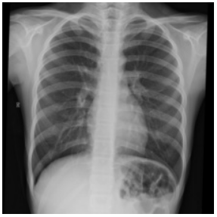
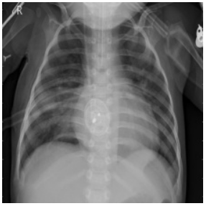
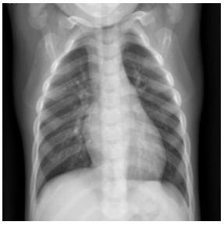
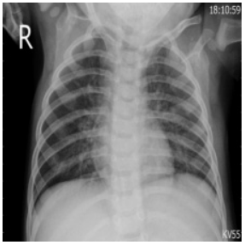
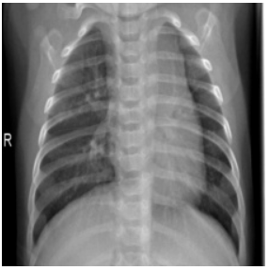
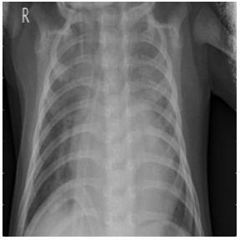
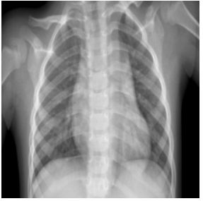
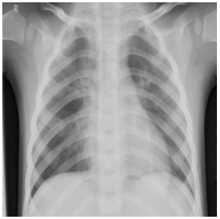
RESULTS
CONFUSION MATRIX
GROUND TRUTH
NORMAL
PNEUMONIA
150
6
NORMAL
PREDICTED
84
384
PNEUMONIA
Notes:
Display here is a confusion matrix of our prediction results. Note that almost all of the misclassified cases are False Positives (normal classified as pneumonia) and only very few false negatives, which is usually a good thing in medical classification.

Slide 17
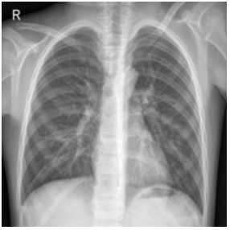
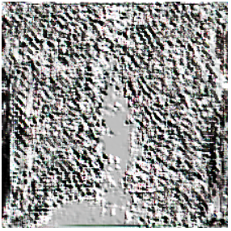
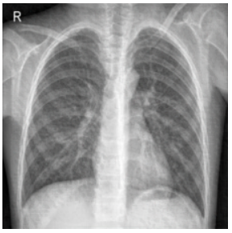
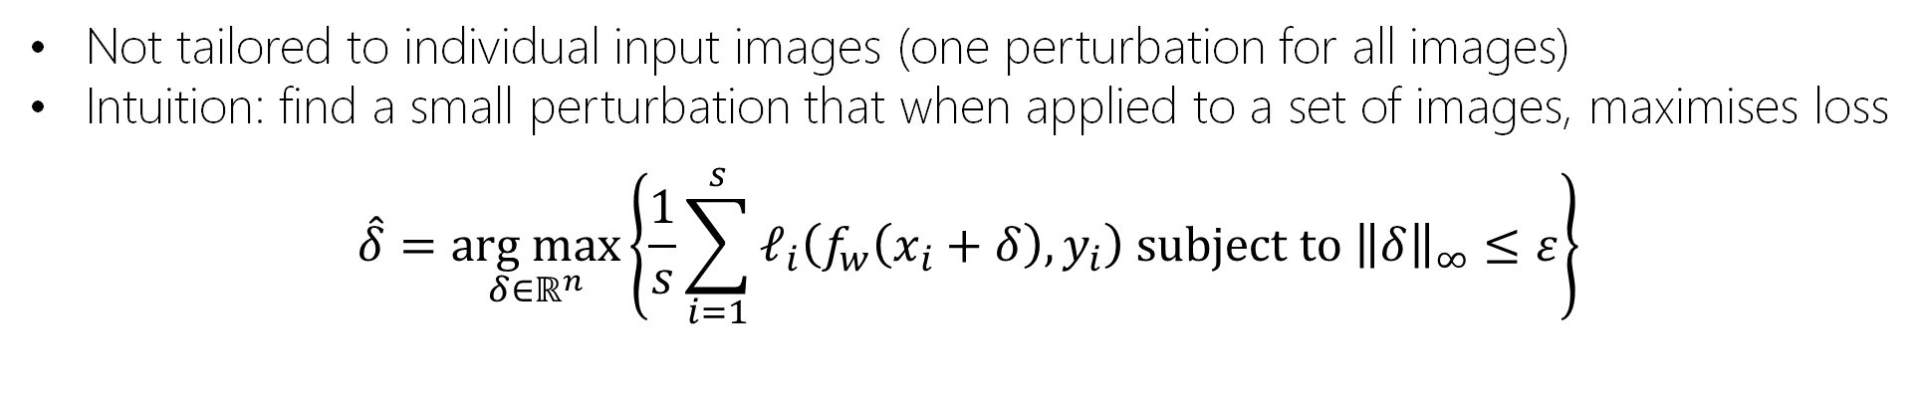

ADVERSARIAL ATTACKS
UNIVERSAL ADVERSARIAL PERTURBATION
Not tailored to individual input images (one perturbation for all images)
Intuition: find a small perturbation that when applied to a set of images, maximises loss
$$\hat{δ}=\underset{δ∈ℝ^{n}}{arg max}\left\{\frac{1}{s}\sum_{i=1}^{s}{ℓ_{i}\left(f_{w}\left(x_{i}+δ\right),y_{i}\right) subject to {\left\|δ\right\|}_{∞}≤ε}\right\}$$
Original Image: NORMAL
Perturbation: $ε=0.02$, Epoch 3
Perturbed Image: PNEUMONIA
Notes:
Universal adversarial perturbation is a form of attack that is independent of individual input. This means that the main output is a single perturbation matrix/vector that can be applied across all images. The main intuition behind the method is to find some small perturbation that maximises the empirical risk / loss of a data set. This can be solved through this optimisation problem tackled in our lectures. Here we make use of the infinity norm more specifically rather than the p-norm in the lecture notes. To solve this problem, we then implemented Projected Gradient Ascent

Slide 18
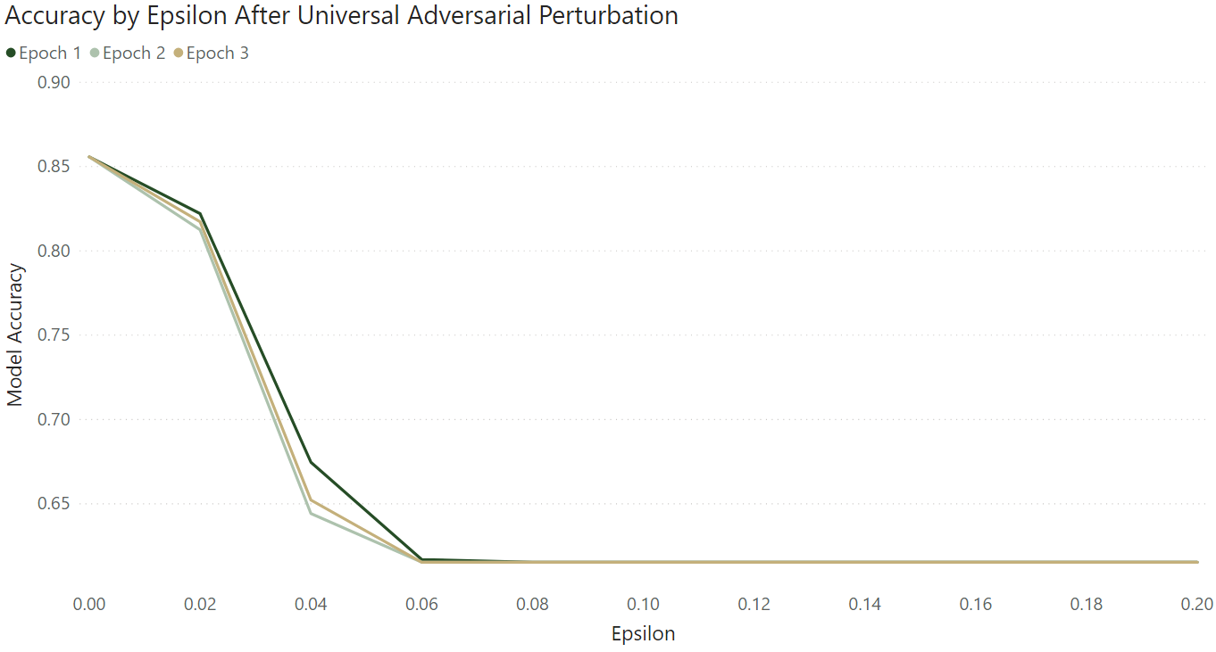
ADVERSARIAL ATTACKS
UNIVERSAL ADVERSARIAL PERTURBATION
Notes:
Results showed that the attack was successful in reducing model accuracy, however, it required relatively large values of epsilon compared to FGSM which we will tackle next. As one can see in this graph, there seems to be a lower bound to the damage done by the attack. With epsilon around 0.06, the model actually simply predicts Pneumonia for all images in the test set, thus while it was able to “convert” images classified as normal to pneumonia, it was not able to do so the other way around. We hypothesize that targeting normal cases was simply how the model could maximise loss.

Slide 19
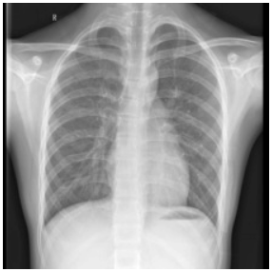
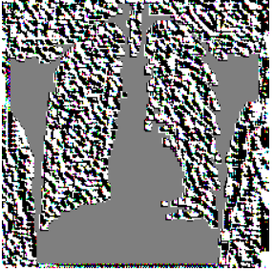
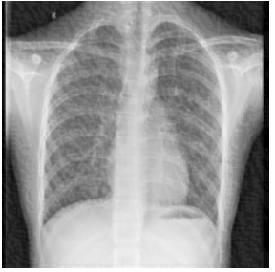
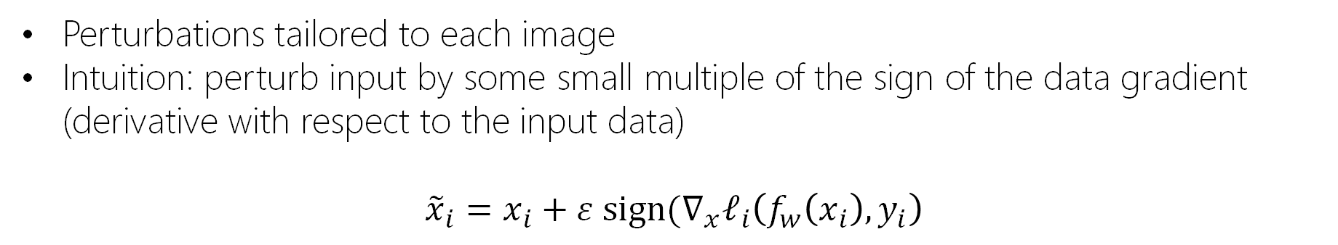

ADVERSARIAL ATTACKS
FAST GRADIENT SIGN METHOD
Perturbations tailored to each image
Intuition: perturb input by some small multiple of the sign of the data gradient (derivative with respect to the input data)
$${\tilde{x}}_{i}=x_{i}+ε sign(∇_{x}ℓ_{i}\left(f_{w}\left(x_{i}\right),y_{i}\right)$$
Original Image: NORMAL
Perturbation: $ε=0.02$
Perturbed Image: PNEUMONIA
Nathan Inkawhich. 2017. Adversarial Example Generation. https://pytorch.org/tutorials/beginner/fgsm_tutorial.html
Notes:
Unlike Universal Adversarial Perturbation, FGSM tailors perturbations to individual images. It attacks images using a perturbation that is a small multiple of the sign of the data gradient (derivative with respect to the input data). This can be formulated with the following expression making use of the derivative of the loss function with respect to the data. This very quickly reduces classification accuracy even with barely perceptible perturbations such as the one shown below.

Slide 20
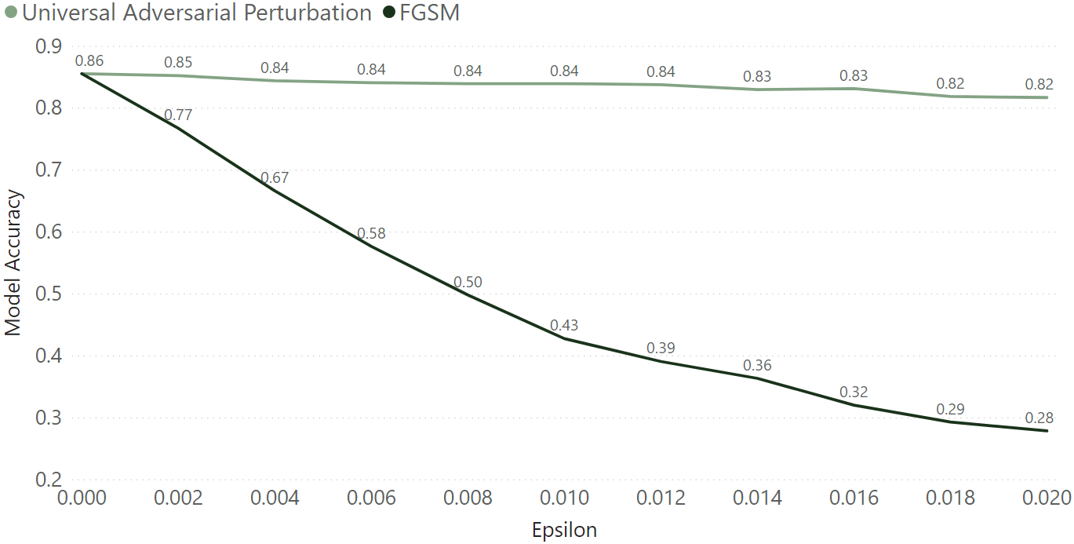
ADVERSARIAL ATTACKS
COMPARISON OF RESULTS
Notes:
The graph here shows the decrease in accuracy as the value of epsilon grows for both FGSM and Universal Adversarial Perturbation. As shown here, FGSM outperforms Universal Adversarial perturbation, especially with the smaller values of epsilon. We also do not encounter the issue with the lower bound to model performance as FGSM is able to attack both cases in the binary classification.

Slide 21


CONCLUSIONS
Classification
Found that it was generally possible to classify PNEUMONIA or NORMAL using chest X-rays and a relatively simple architecture that fits in a consumer GPU
Adversarial Attacks
Both methods implemented reduced model accuracy
FGSM can do more damage even with smaller values of $ε$
For Further Study
Data actually includes viral and bacterial pneumonia labels: interesting to try multi-class classifier
Notes:
We found that it was generally possible to classify Pneumonia or Normal chest x-rays using a relatively simple architecture that fits in a consumer GPU with reasonable training times. With regard to adversarial attacks, both methods worked, but FGSM was able to do more damage with smaller values of epsilon. For further study, the data actually includes tags on viral and bacterial pneumonia so it would be interesting to convert this to a multi-class classification problem.

Slide 22
SOURCES
NHS. 2019. Pneumonia. https://www.nhs.uk/conditions/pneumonia/
Paul Mooney. 2018. Chest X-Ray Images (Pneumonia). https://www.kaggle.com/paultimothymooney/chest-xray-pneumonia
Stéfan van der Walt, Johannes L. Schönberger, Juan Nunez-Iglesias, François Boulogne, Joshua D. Warner, Neil Yager, Emmanuelle Gouillart, Tony Yu, and the scikit-image contributors. 2014. scikit-image: Image processing in Python. https://doi.org/10.7717/peerj.453
Andrew Ng. 2017. C4W2L02 Classic Network. https://www.youtube.com/watch?v=dZVkygnKh1M
Weidong Xu, Zeyu Zhao, and Tianning Zhao.Tutorial: Dropout as Regularization and Bayesian Approximation. https://xuwd11.github.io/Dropout_Tutorial_in_PyTorch/
Leslie Smith. 2017. Cyclical Learning Rates for Training Neural Networks. https://arxiv.org/pdf/1506.01186.pdf
Gao Huang, et al. 2017. Snapshot Ensembles: Train 1, Get M For Free. https://arxiv.org/abs/1704.00109
Ayoosh Kathuria. 2018. Intro to optimization in deep learning: Momentum, RMSProp and Adam. https://blog.paperspace.com/intro-to-optimization-momentum-rmsprop-adam/
Davide Chicco, and Giuseppe Jurman. 2020. The advantages of the Matthews correlation coefficient (MCC) over F1 score and accuracy in binary classification evaluation. https://bmcgenomics.biomedcentral.com/articles/10.1186/s12864-019-6413-7
Nathan Inkawhich. 2017. Adversarial Example Generation. https://pytorch.org/tutorials/beginner/fgsm_tutorial.html
All icons used throughout the presentation are from https://www.iconfinder.com/ used under their free “No link back” licenses, which do not require attribution
Background image on first slide from www.pexels.com which is free and does not require attribution
Notes:
The graph here shows the decrease in accuracy

